Slide 1



Slide 2
Workshop
2023

Slide 3
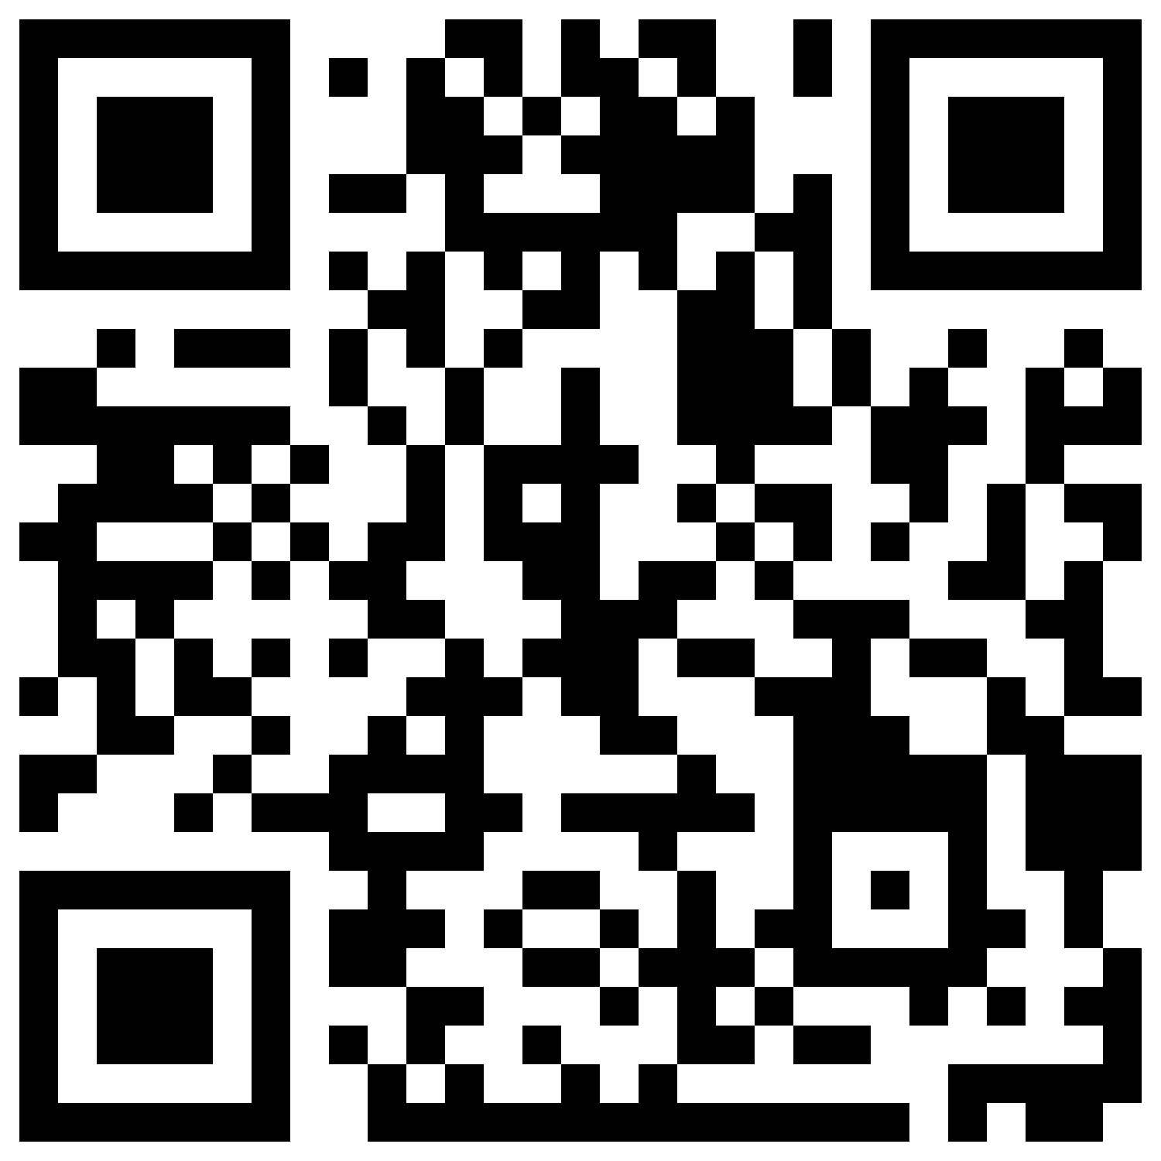
Visit our website
Phd Student Commission

Slide 4


Futsal
FIND OUT MORE

Slide 5

Tabletop
FIND OUT MORE

Slide 6


World Cup

Slide 7

Running
FIND OUT MORE

Slide 8

Volleyball
FIND OUT MORE

Slide 9
LASIGE Welcome Day

Slide 10
Commission Social Activities

Slide 11
LASIGE Lunch Fridays

Slide 12
LASIGE Forum

Slide 13
Workshops

Slide 14
Commission Clubs

Slide 15
“The PhD student committee made me see that there are many more people besides my research group.”
“All the initiatives that existed allowed people, at their own pace, to be able to expose themselves and connect with other groups. I also think it made the dimension that LASIGE has more clear, because before it was a somewhat mysterious entity.”

Slide 16
“Thanks to the commission's events and amazing people, I feel so much more integrated in LASIGE's fabric. I think the commission has been doing an essential job in bringing people together after a time of deep isolation. Thank you!”
“I participated in the LASIGE Forum, which was interesting to get to know people from other areas and also learn a bit on how to give great talks and deal with rejection of a paper (thank you Alysson!).”

Slide 17
“This commission has made my PhD journey at LASIGE more pleasant. Everyone should engage in upcoming activities and get the chance to meet new people outside their research field. The ability to excel is also a result of personal connections!”
“The commission organized a visit to Coimbra, which allowed me to disseminate part of my work with other students of the same area, possibly allowing me to start new collaborations.”

Slide 18
“Before the beginning of the year, the relations I had were strict to the peers within my research group or research area. There was not much communication with other groups, other people. Some of the events organized by the commission actually helped me in this sense.”
“These last few months, were probably the best for me at LASIGE, I had people to support me, I could feel the presence of others, I could feel a community.”

Slide 19
“When I talk with other researchers from different centers in Portugal I am very proud to say that I know most PhD students from our research center and that I can easily reach out with research questions, proposals or just to hang out. Which is something that does not happen very often in other centers.”
“I met new people, with the same interests as me and made unexpected friendships.”

Slide 20
“The events offered by the PhD Commission made me feel like I have a community of peers that I can count on. I feel seen and that everyone has the same struggles, self doubts and fears. Having this community made me feel less alone in this lonely path that is the PhD.”
“Now, I should also say that I know it takes a lot of work and effort to organize these activities and I value it a lot. So commission, please don't give up and to other researchers please support this initiative.”

Slide 22
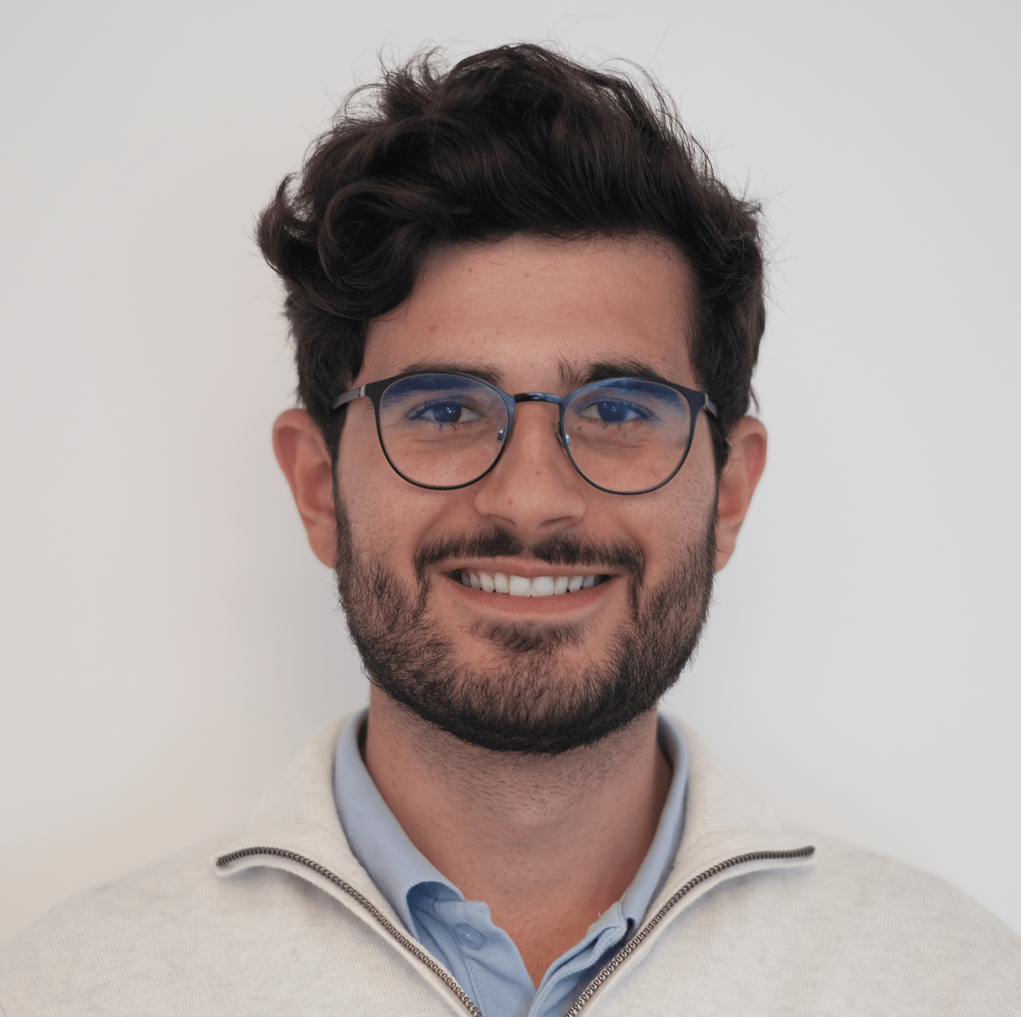

Slide 23
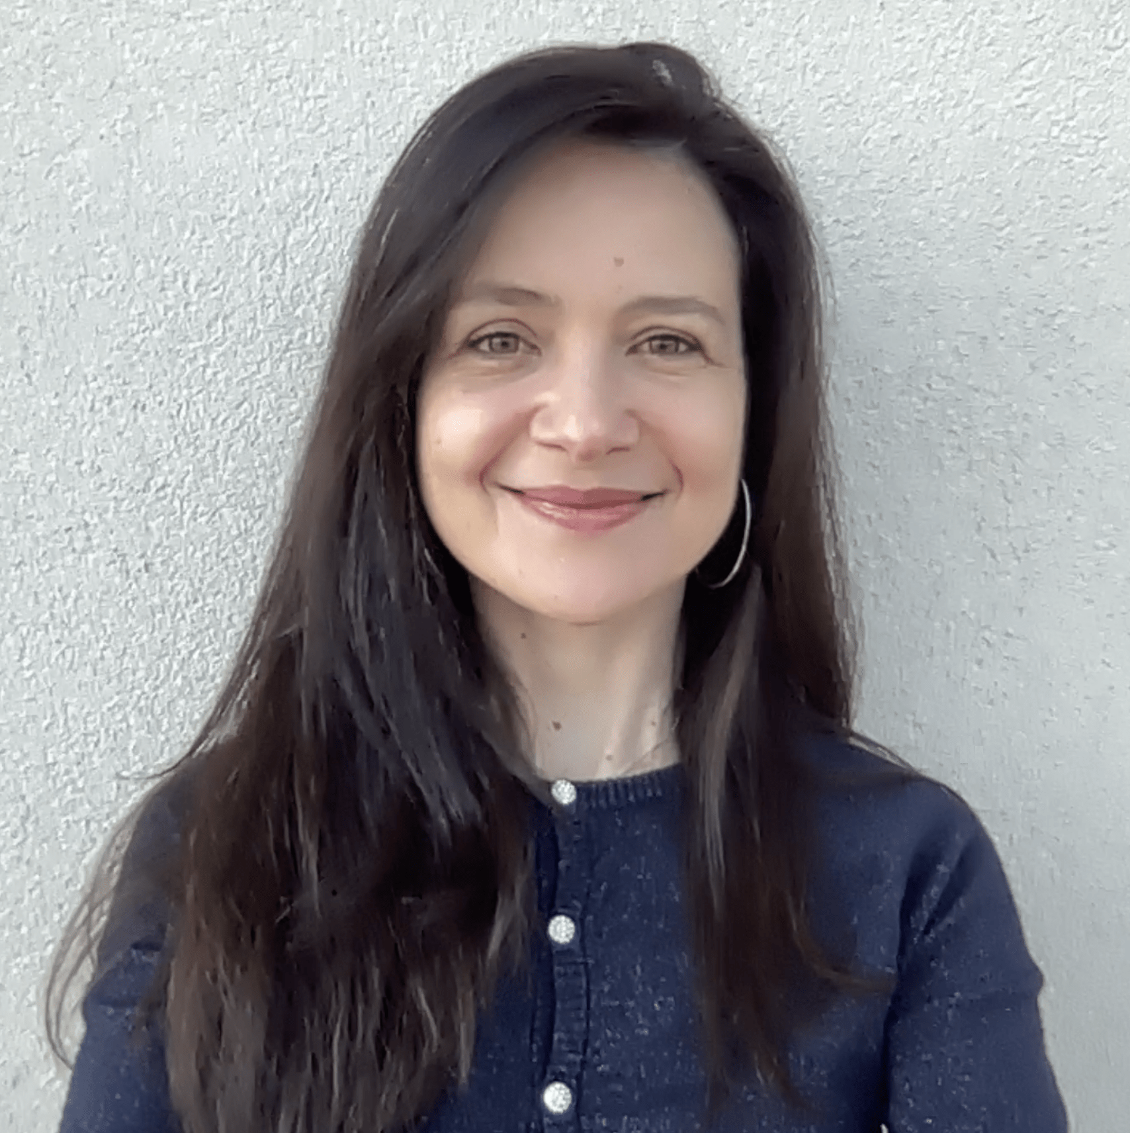

Slide 24
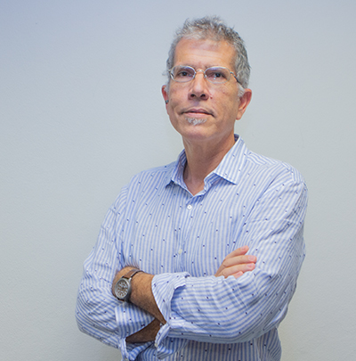

Slide 25
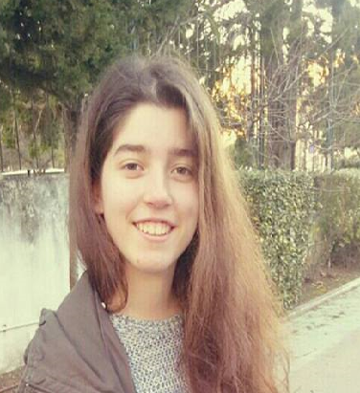

Slide 26
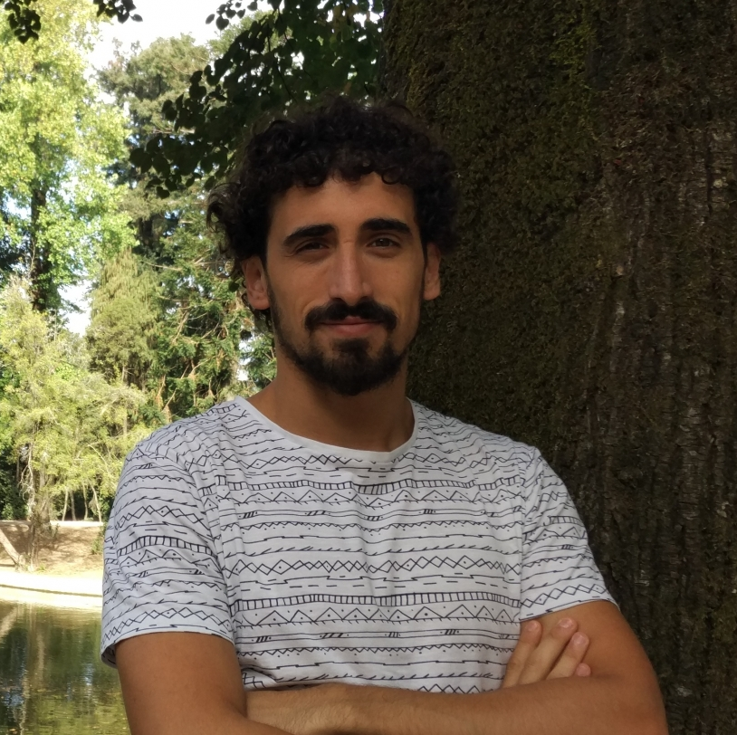

Slide 27
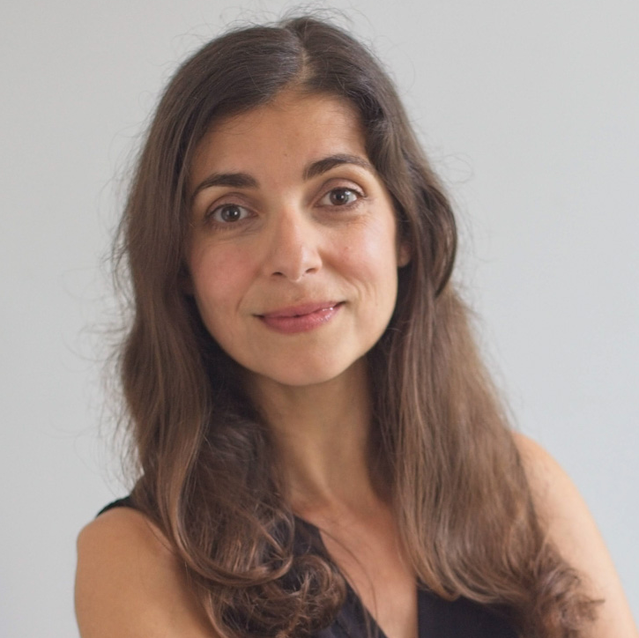

Slide 28
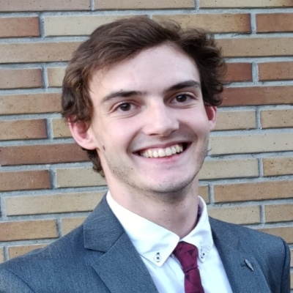

Slide 30
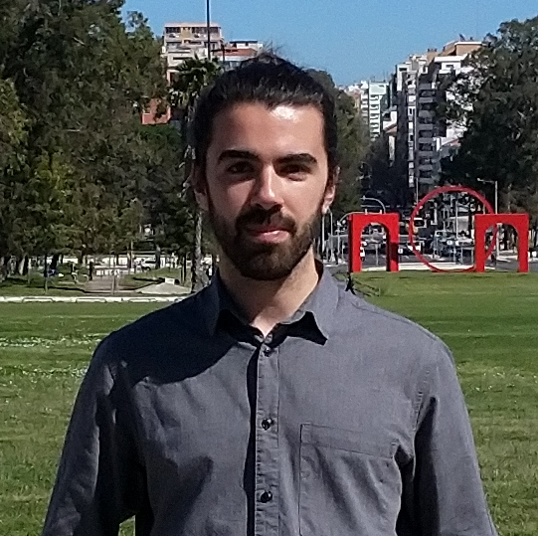

Slide 31
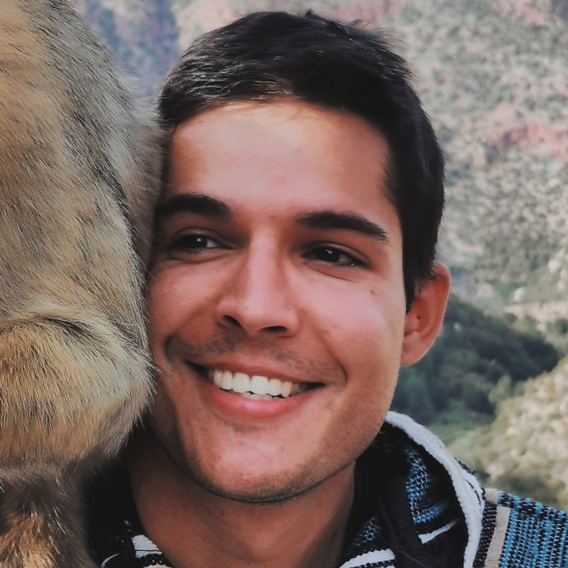

Slide 33
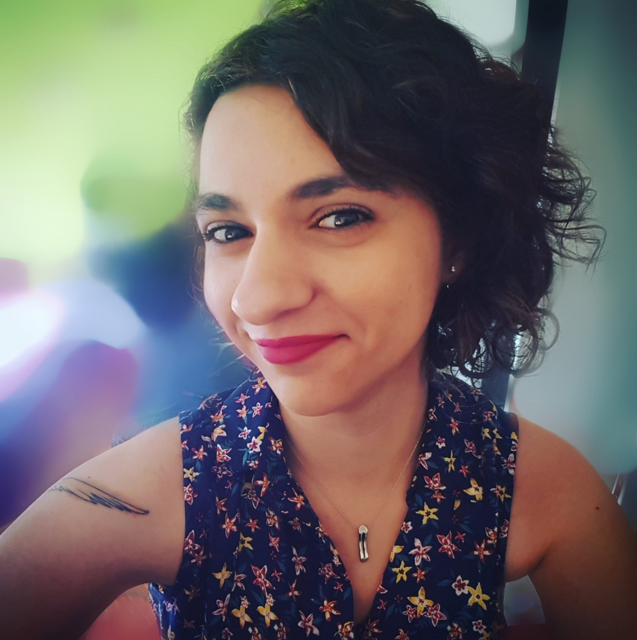

Slide 34
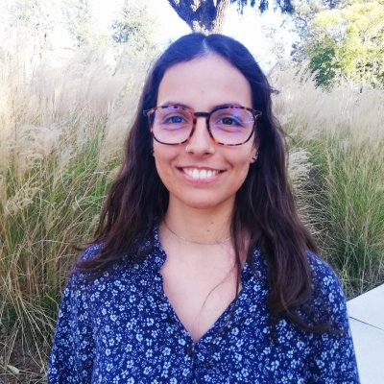

Slide 35
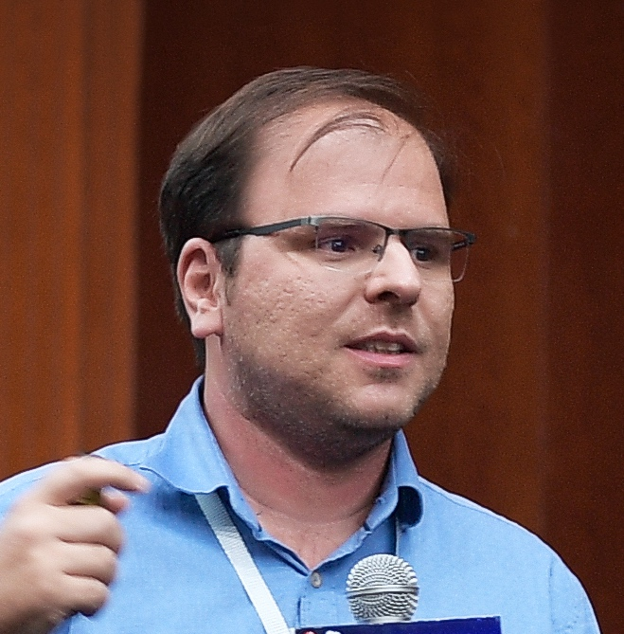

Slide 36
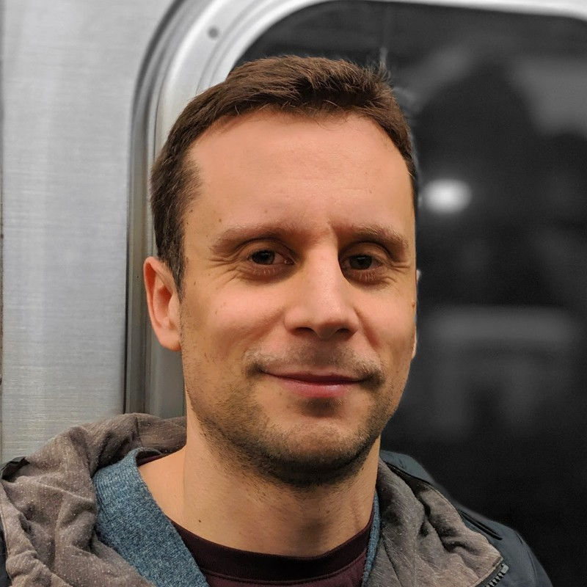

Slide 37
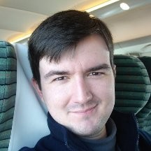

Slide 38
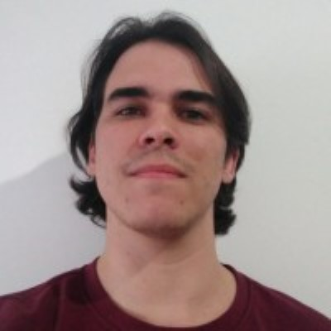

Slide 39
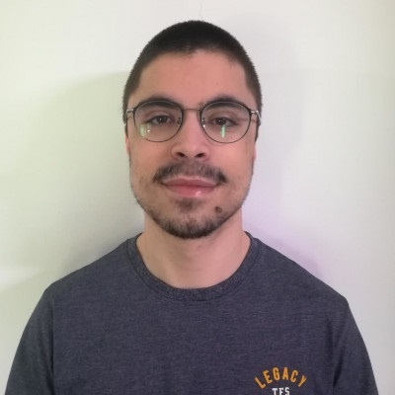

Slide 40
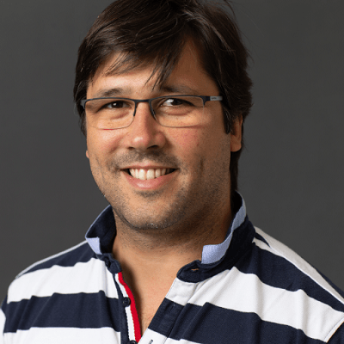

Slide 41
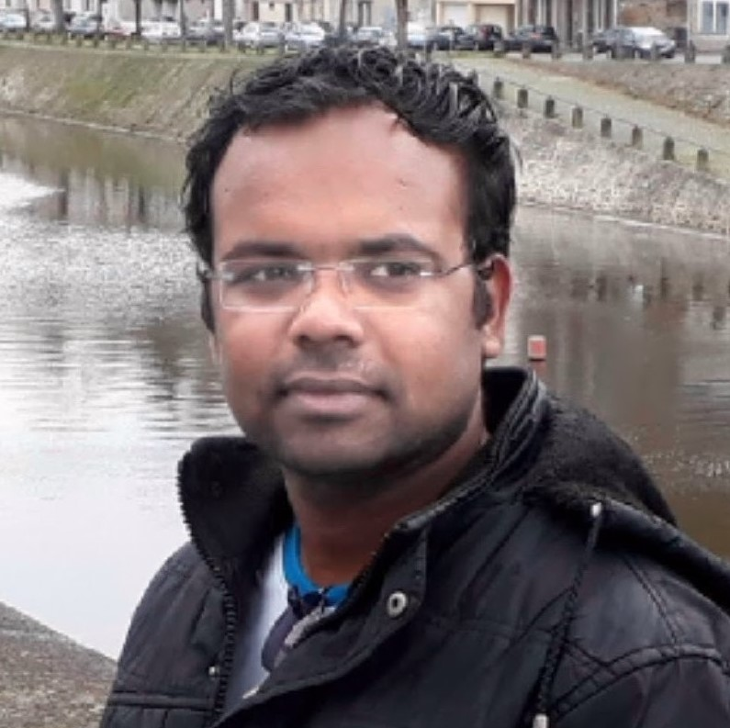

Slide 42
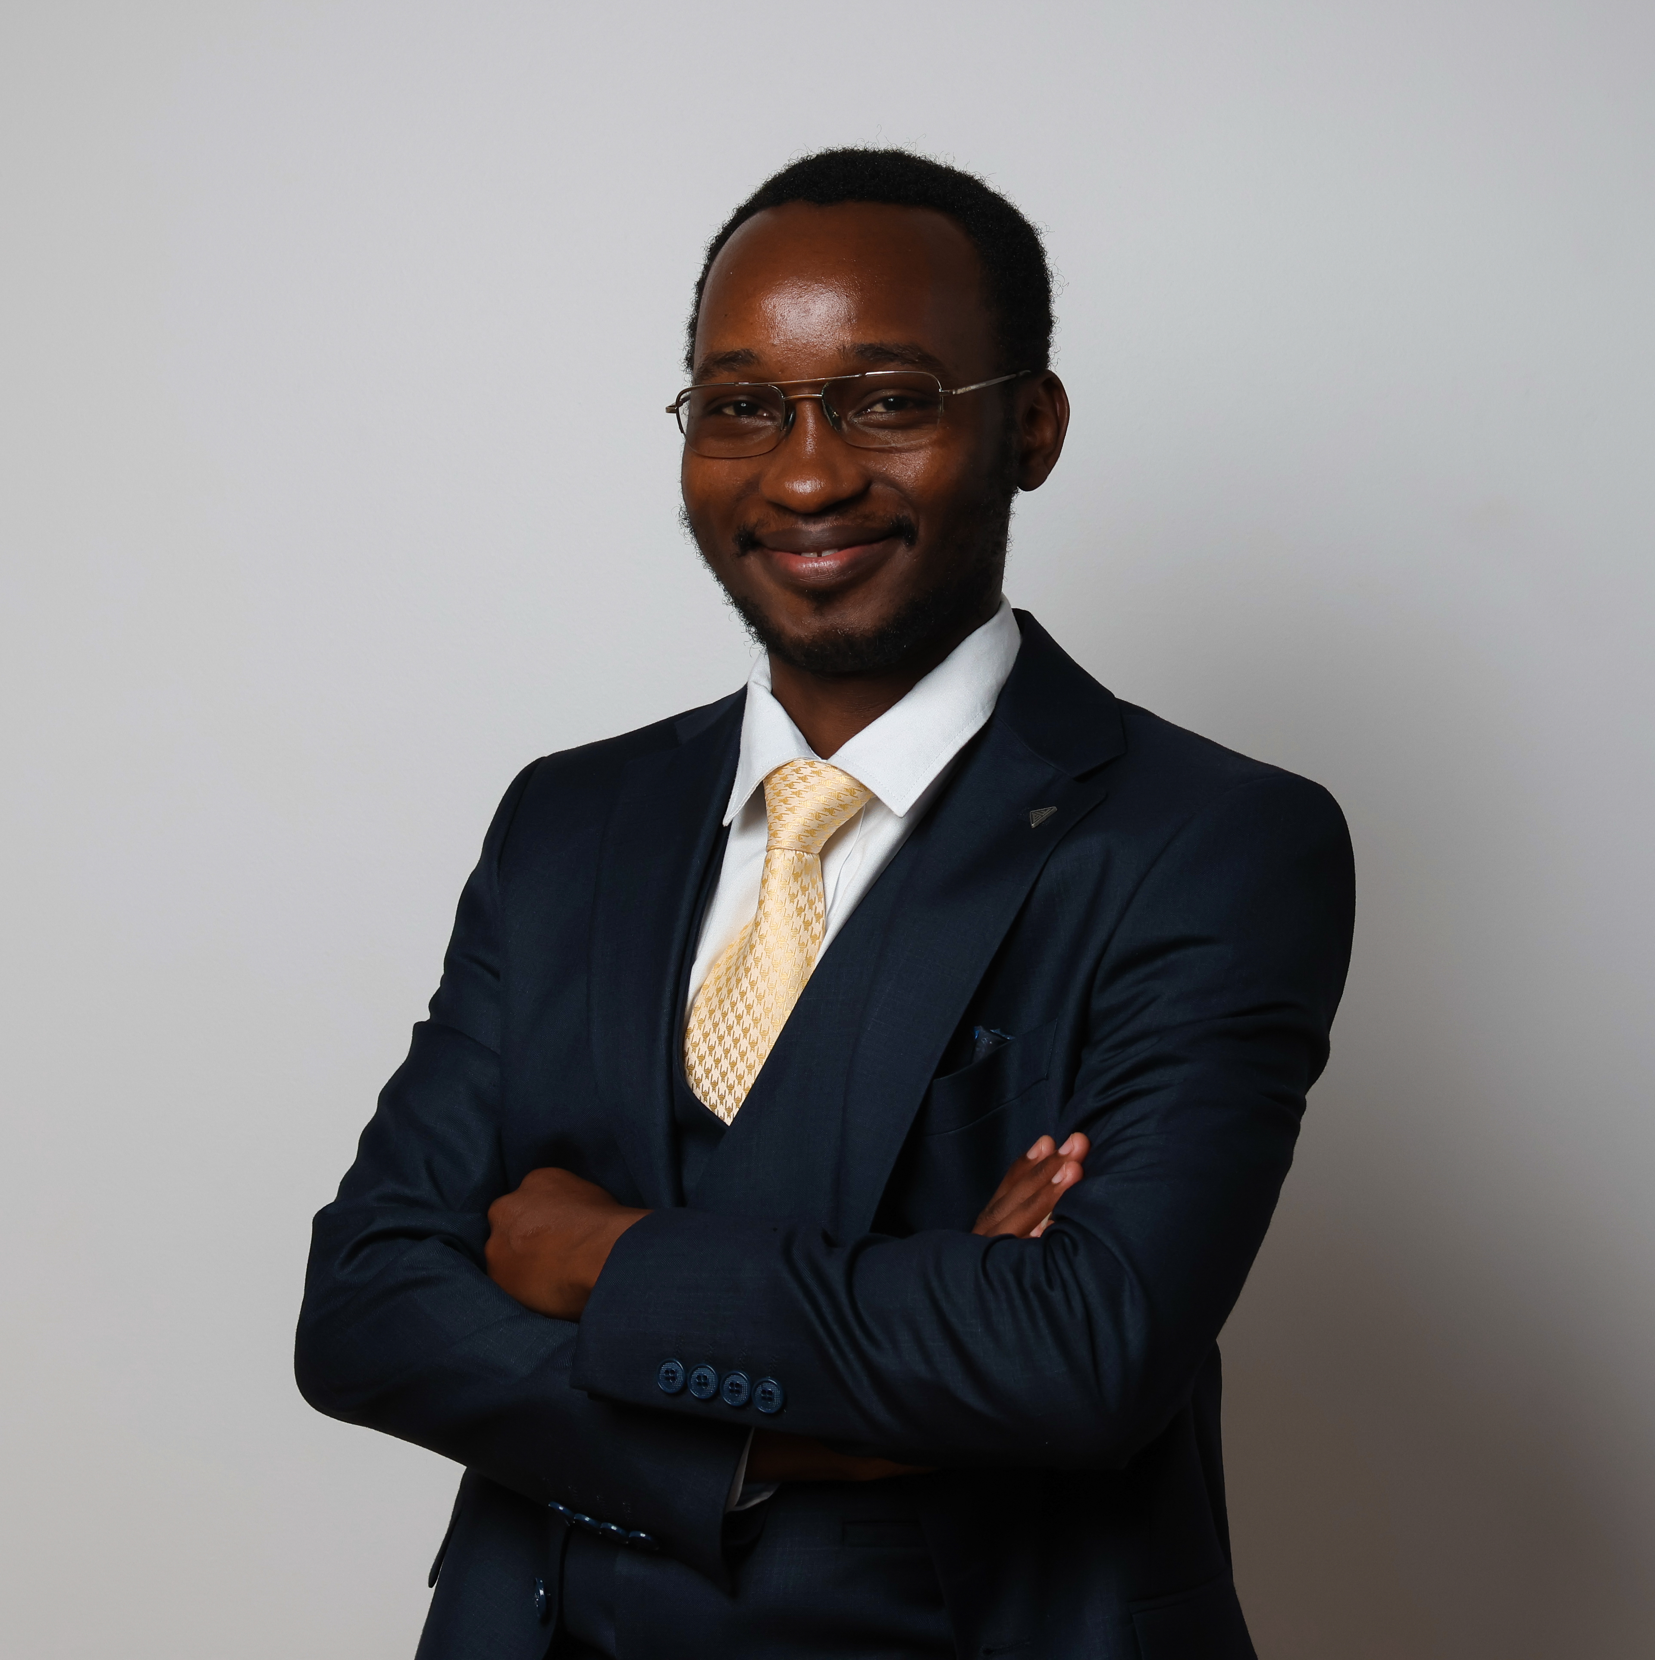

Slide 43
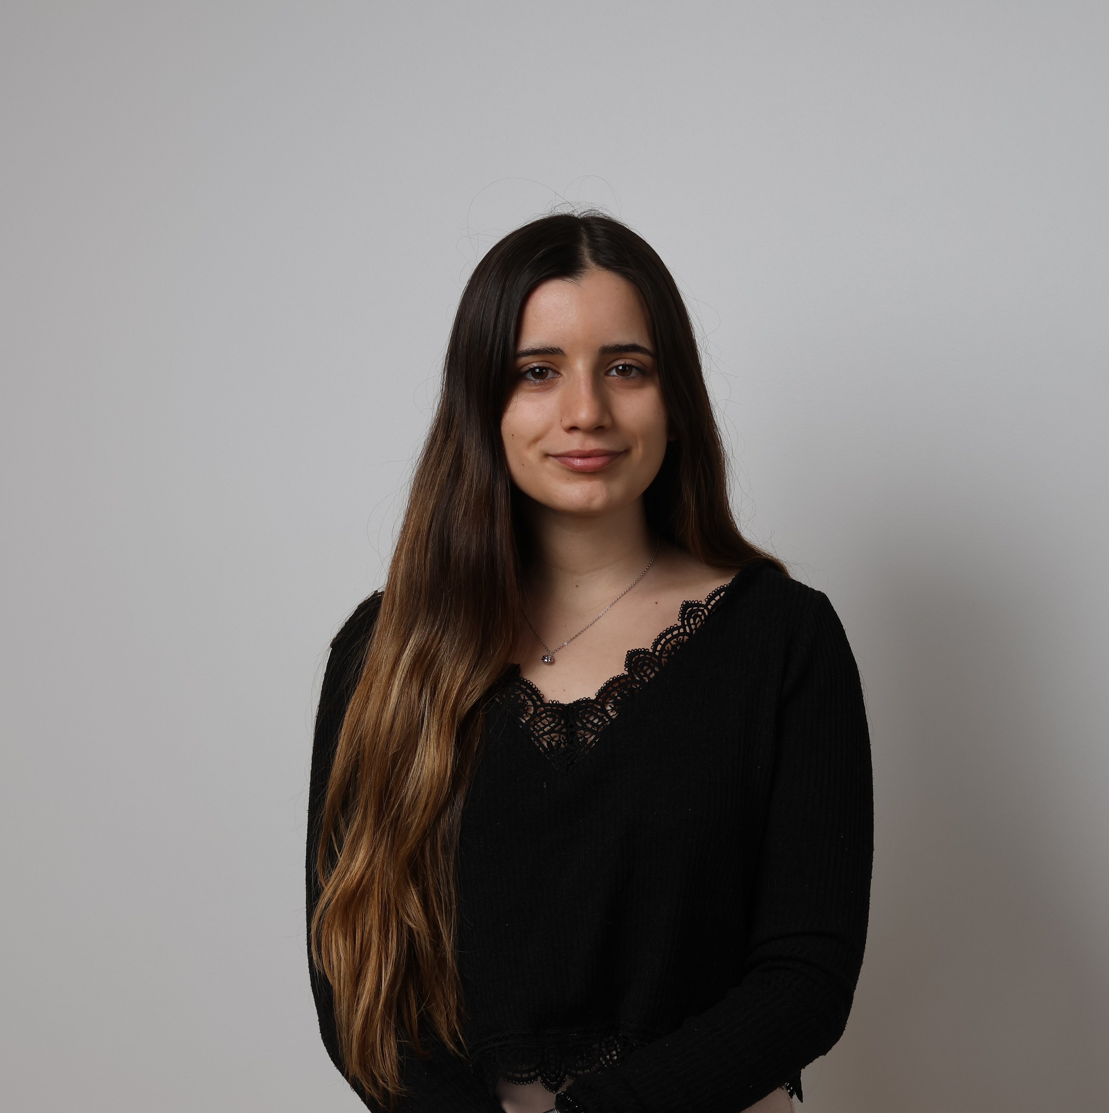

Slide 44
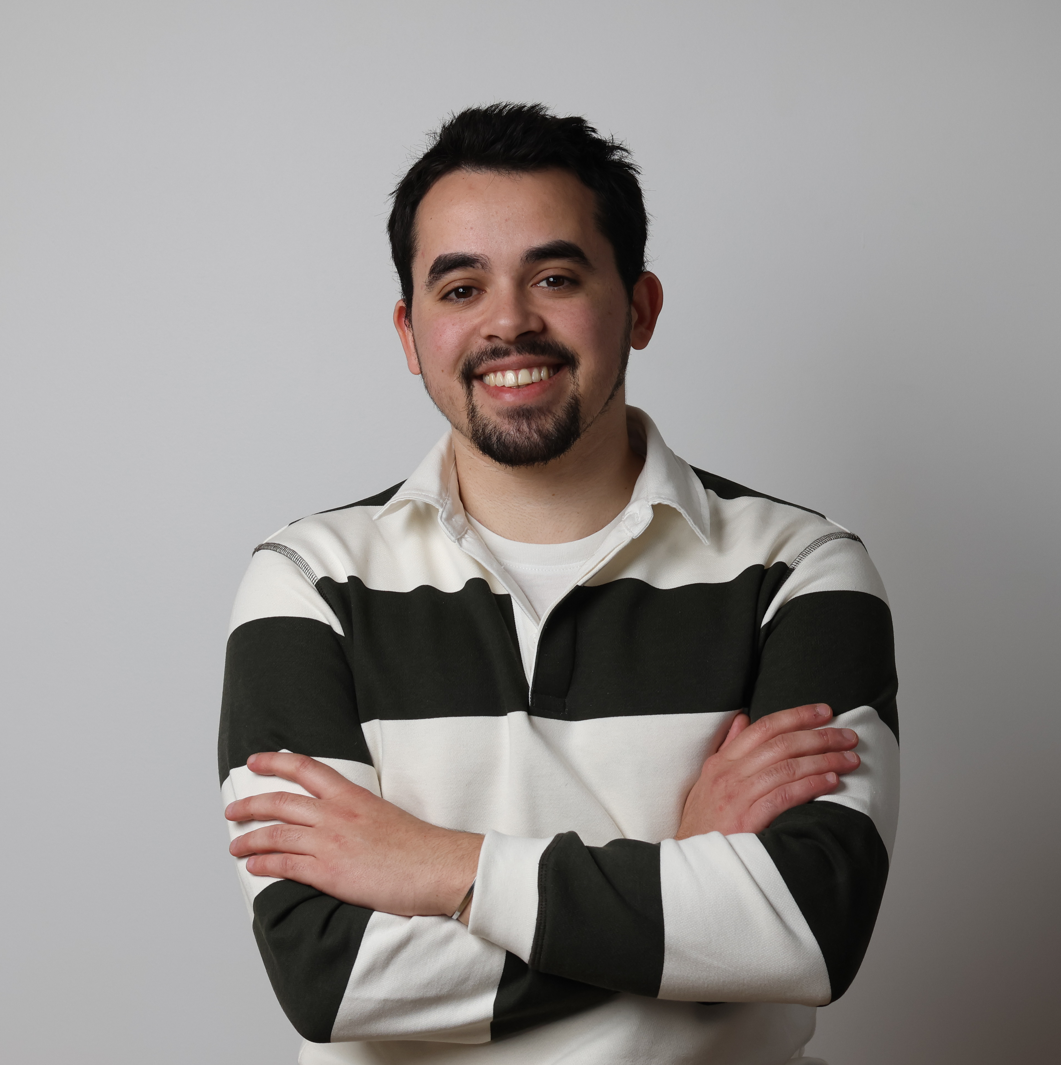

Slide 45
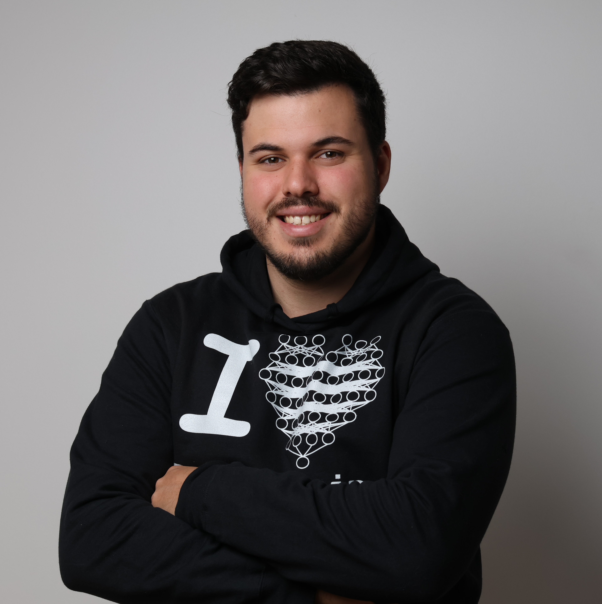

Slide 46
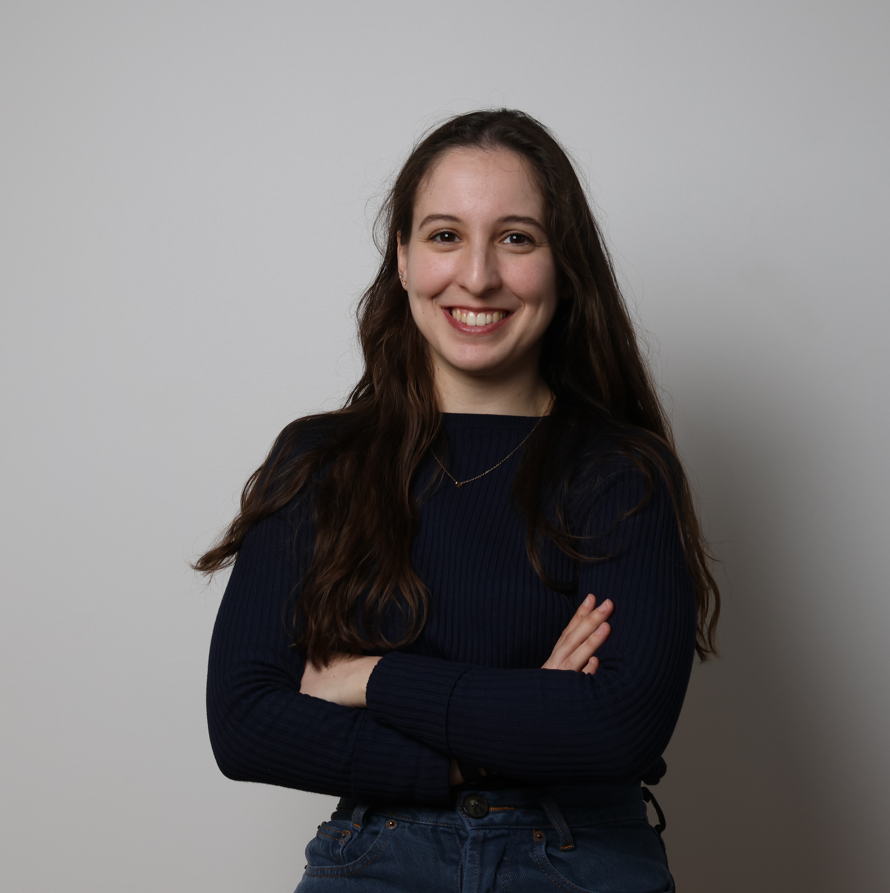

Slide 47
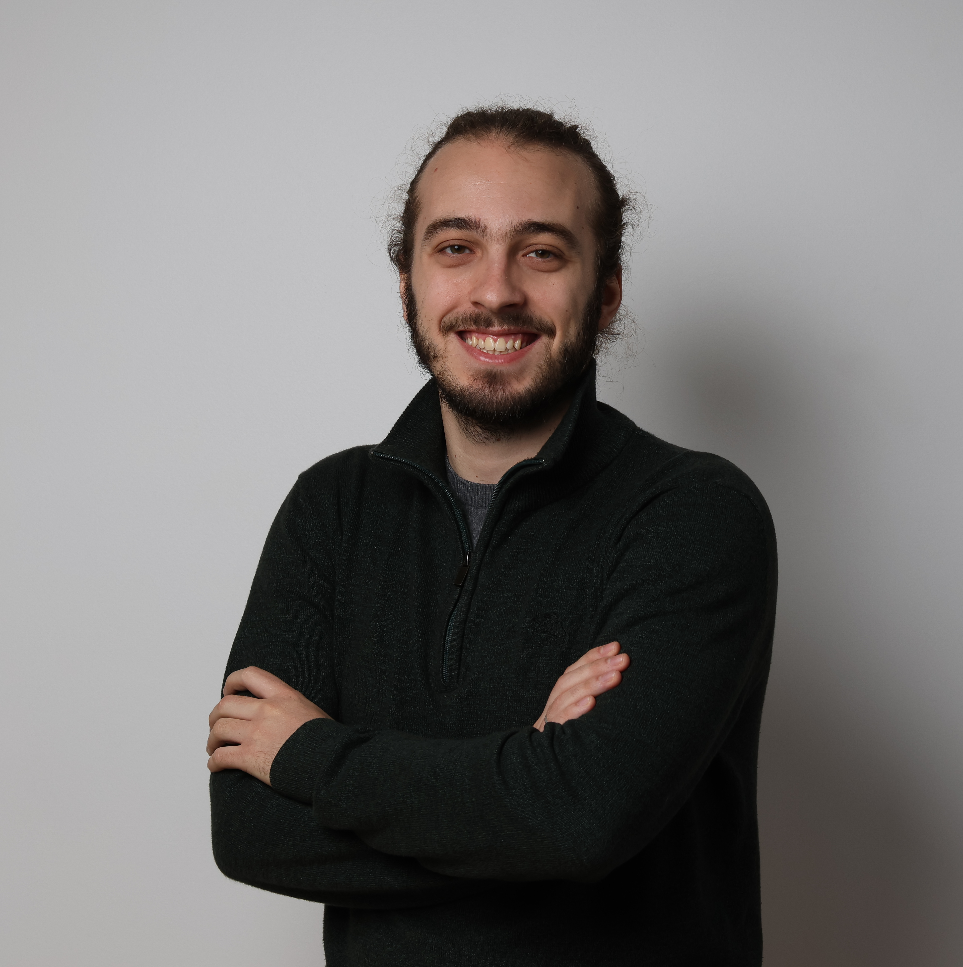

Slide 48
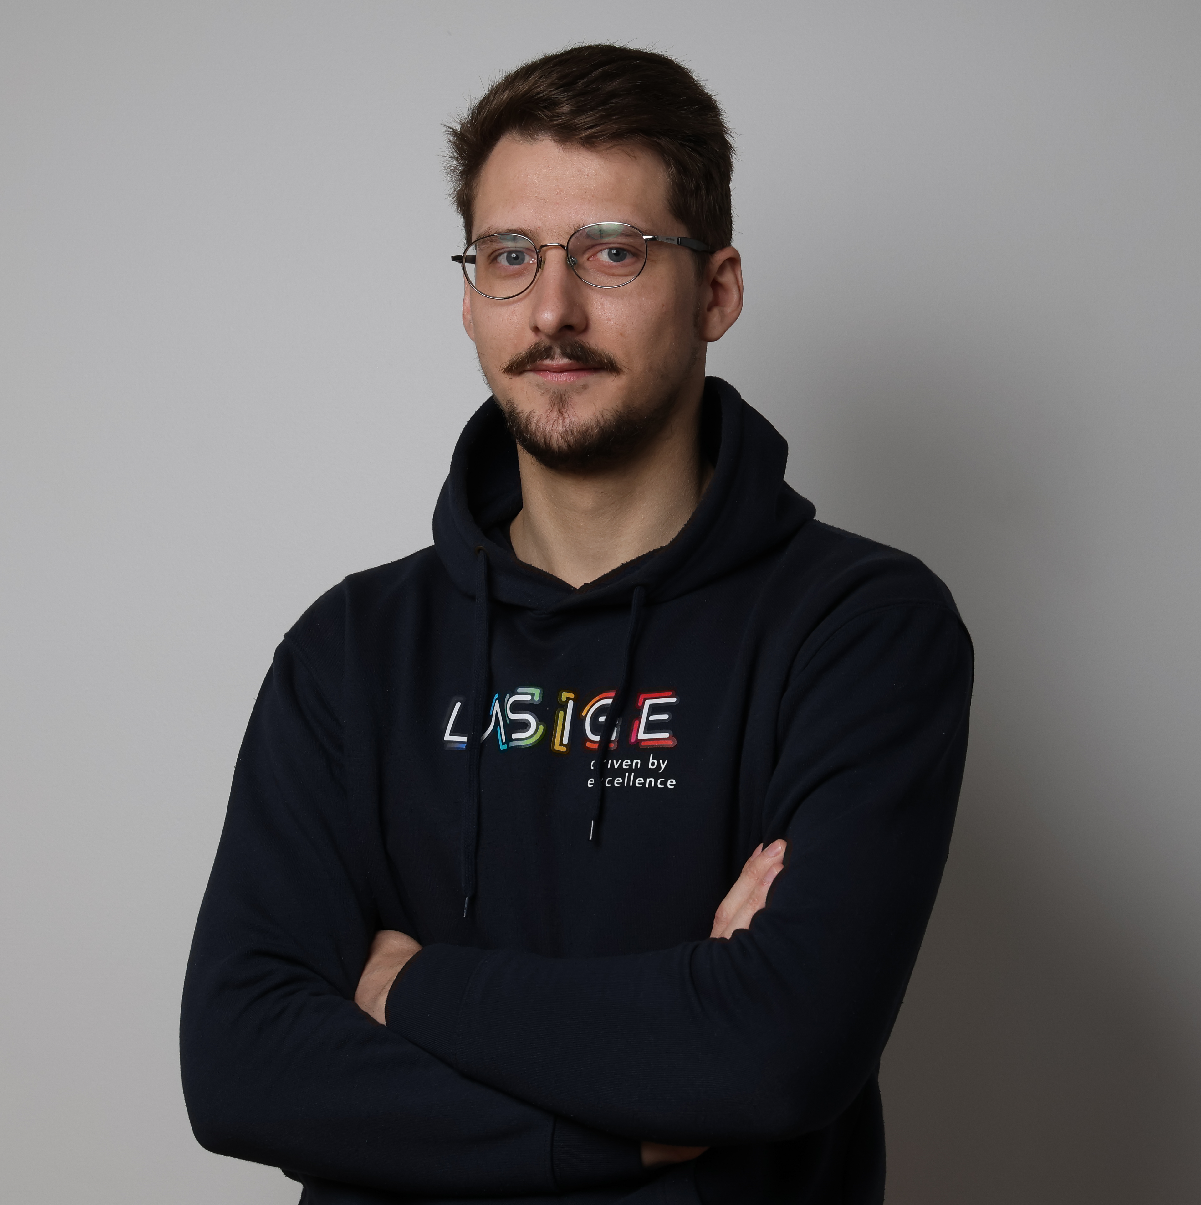

Slide 49
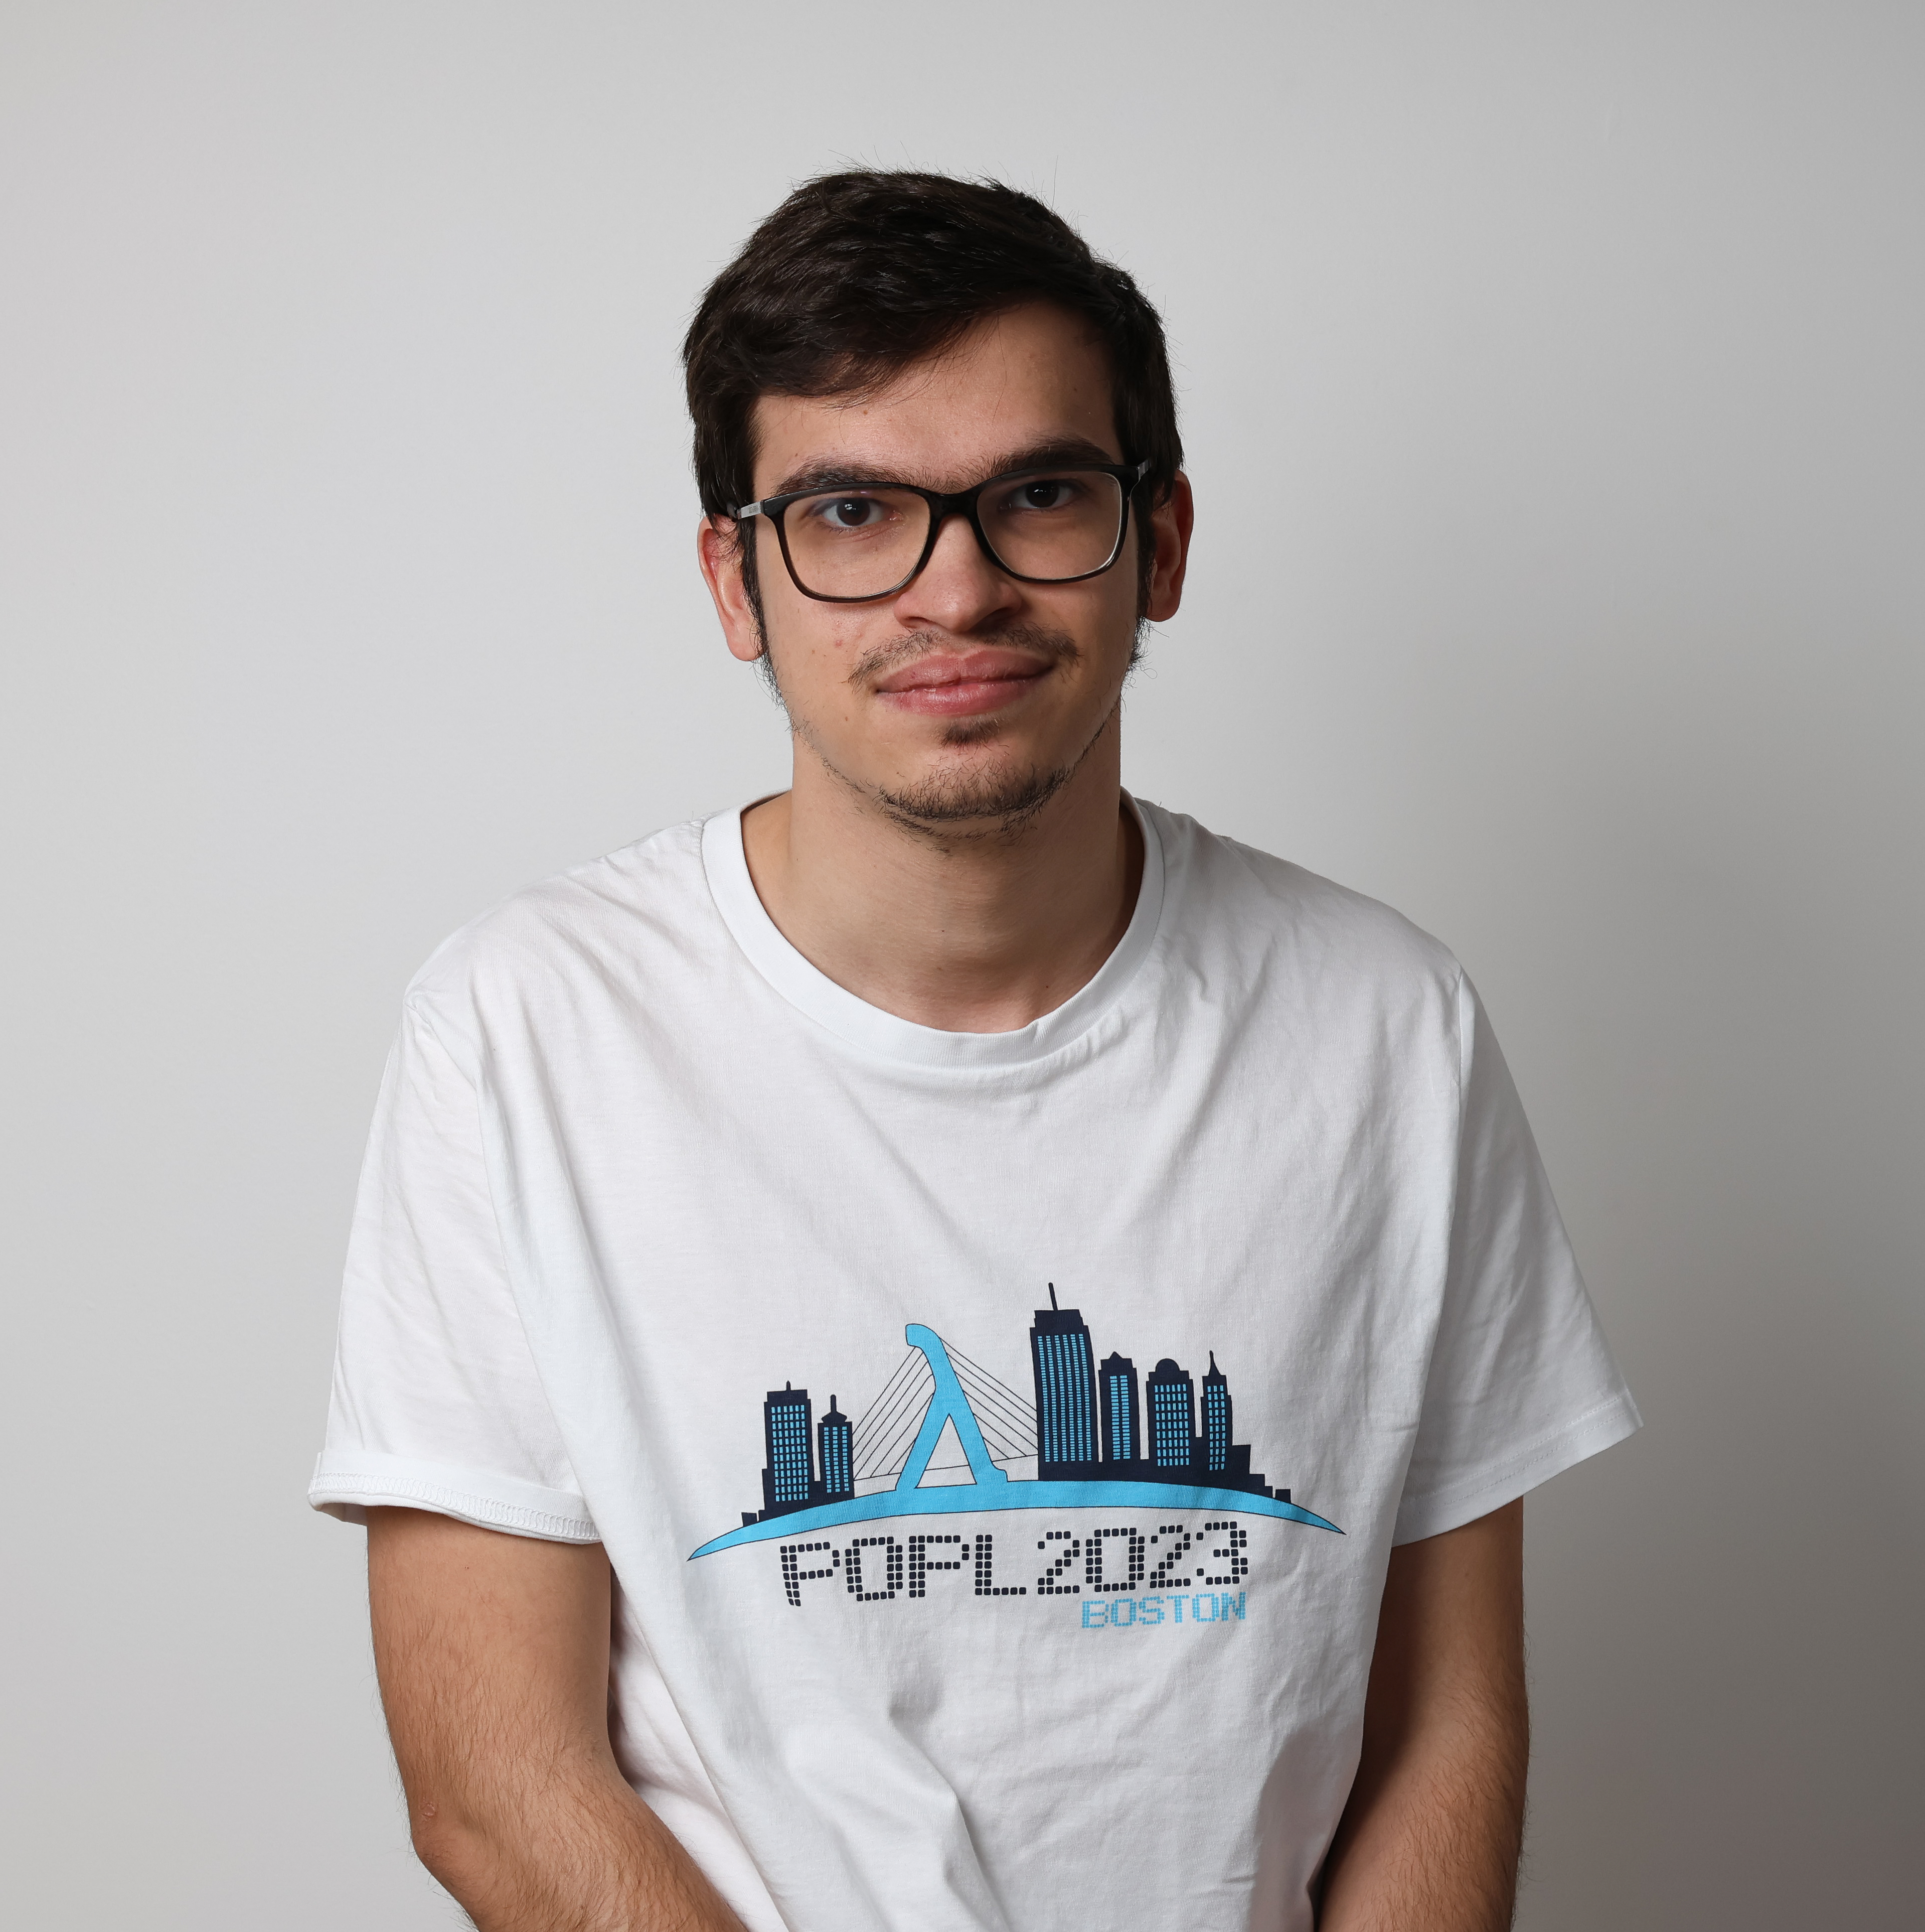

Slide 50
